Slide 1
Human rights based approach to food security in the age of climate change
Hilal Elver
3 July 2019
University of Sydney School of Law

Slide 2
Major points
State of food insecurity and malnutrition
Overview of Human Rights to adequate food
Thinking critically about today’s food system governance
Challenges arising from climate change
Taking global action for future

Slide 3
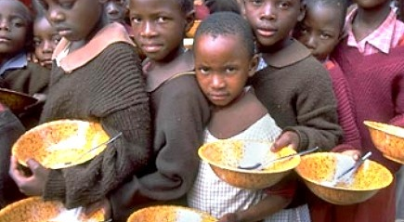
I. State of food insecurity
In 2015, 777m. In 2017 815mil. In 2018, 821 m
11% increase of hunger
1,5 m. children risk of death

Slide 4
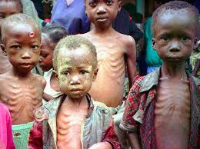
Global Malnutrition
5 to 6 million children die every year from malnutrition and related diseases
151 million under 5 stunted & wasted ( 50 mil);
38 mil. overweight
2 billion suffer from undernutrition, and micronutrient deficiency
1.2 billion adult are overweight and 700,000 obese

Slide 5
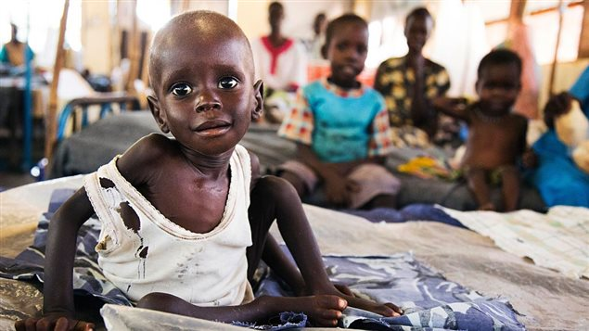
35 m. in North East Nigeria, South Sudan, Somalia, Yemen, plus Myanmar, DRC in imminent danger of famine
Notes:
10 March 2017 UN declared famine.
South Sudan. 5.5 million are severe food insecure.
North East Nigeria 5 m.
Somalia 6.7 m.
Yemen 14 million. Syria

Slide 6
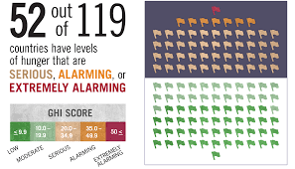
2018 Global Hunger Index
113 m. alarmingly food insecure

Slide 7
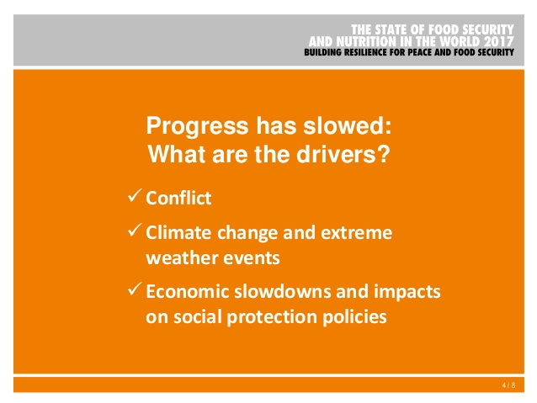
Why hunger increasing?

Slide 8
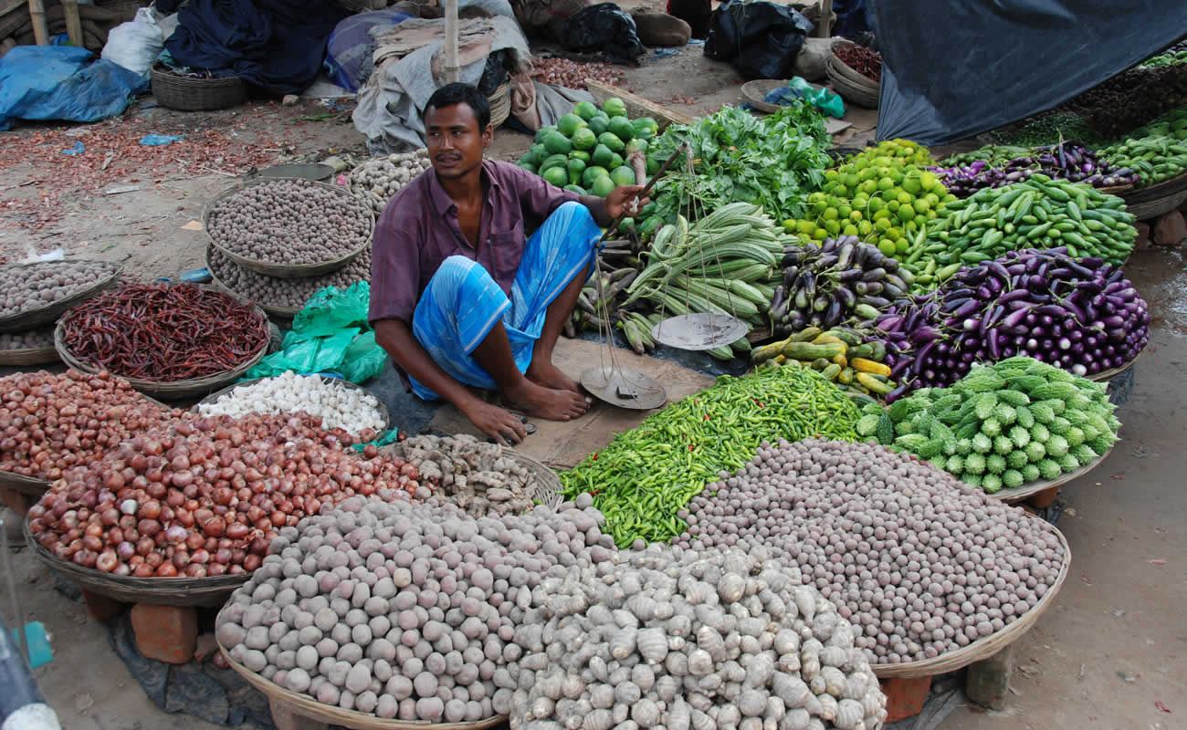
95 % of them live sub-tropic regions, climate insecure places in Sub-Saharan Africa, South Asia and Small Island States;
Most of them small holder or landless farmers in remote villages, and indigenous people;(500 million)
They produce %70 of the local food with % 30 of the land.
Notes:
Small holder and susbsistance farmers

Slide 9
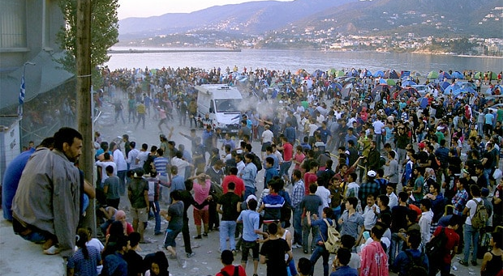
As a result of climate + War: Migration is the highest problem

Slide 10
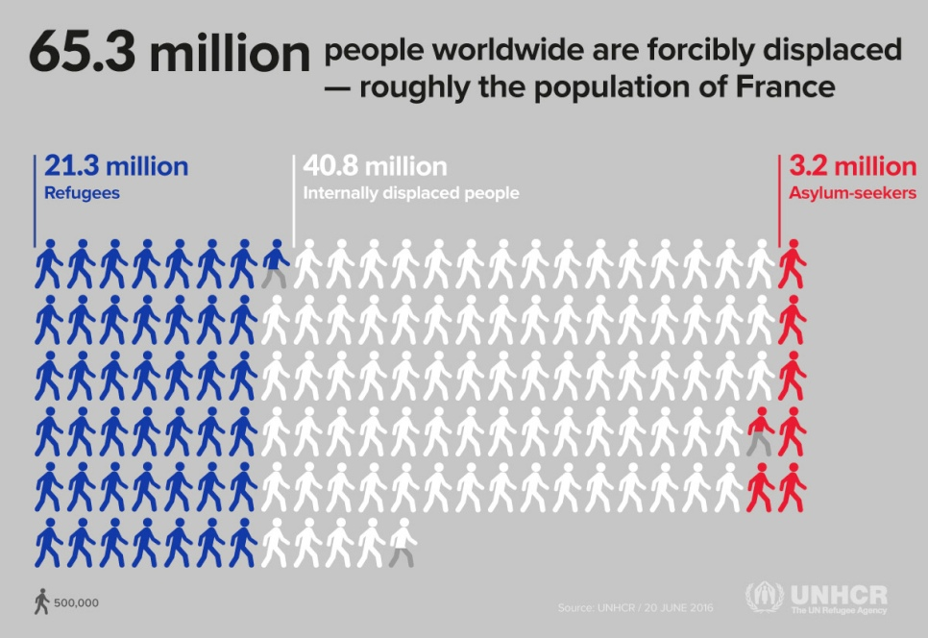

Slide 11
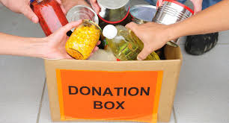
II. What is right to Food?
It is not a right to be fed, it is not charity…
Notes:
Right to food requires the possibility either to feed oneself directly from productive land or other natural resources, or to purchase food.
Right to feed oneself in dignity

Slide 12
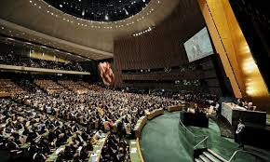
HISTORY: From 1948 UDHR, Art.25
To 1966 ICESCR Art.11
Notes:
From aspirational document to legally binding treaty

Slide 13
Legal Structure of the Right to Food
Right to Food
Convention on Child Rights
UDHR Art.25
ICESCR
Art.11
CEDAW
Voluntary Guidelines 2004
General Comment 12 UNHRC
Notes:
UDHR. Art 25: [Everyone has the right to a standard of living adequate for the health and well-being of himself and of his family, including food.”

Slide 14
Covenant of the ESCR Art. 11
States: Duty Bearer
Citizens: Right holder
Right to Food
Respect
fulfill
protect

Slide 15
Availability
Accessibility
Adequacy
Sustainability
Article 11

Slide 16
Domestic Legal Structure
National Constitutions
Framework Laws
Sectoral laws and regulations

Slide 17
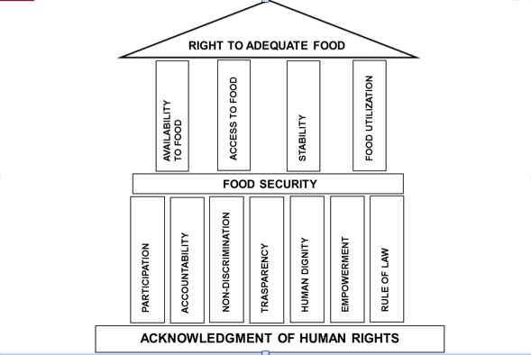

Slide 18
HUMAN RIGHTS BASED APPROACH TO FOOD SECURITY: Feed the world fairly and equitably
People centered, measurable policies
Participation into decision making
Transparency
Monitoring and Accountability: Access to justice
Non-discrimination: Gender equality
Policy coherency: Sustainable development, poverty reduction, climate change response, trade and economy

Slide 19
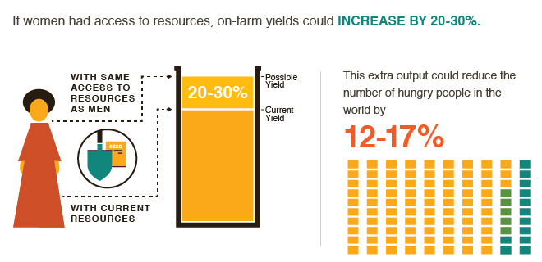
GENDER EQUALITY & WOMEN EMPOWERMENT

Slide 20
III. Critical thinking about today’s food systems challenges
1. Growing inequality and poverty in rural areas and peripheries of cities
2. Increased migration and IDPs
3. Hunger and malnutrition are increasing even affluent societies as by product of neo-liberal global capitalism
4. Climate change
5. Commodification of agriculture

Slide 21
5. Commodification of agriculture:
Trade agreements, neoliberal economic policies
Rise in cheap monoculture, export oriented agriculture
Loss of biodiversity, unhealthy earth
Highly processed, low nutrients food that causes Non communicable diseases
Use of excessive pesticides, agro chemicals
Productive resources are under threat
Consolidation of land
Farmers are losing seeds to big companies

Slide 22
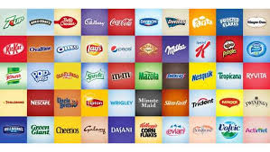
Who controls the food system?
The 10 controls the whole system: Oligopoly
  4 companies produce 60 % of the world seeds
  4 firms account 97% of poultry genetics R & D
  4 produce more than 60 % of the agrochemical that farmers use
7 billion consumers and 1.5 billion food producers, no more than 500 companies control 70 % of food choice. ( Oxfam rep Behind the brands)

Slide 23
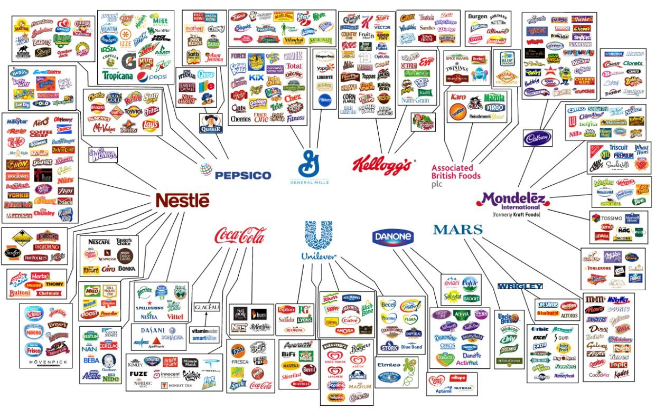

Slide 24
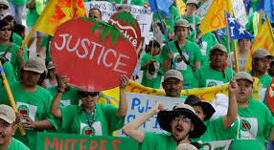
Abusing agriculture & food chain workers for cheap food

Slide 25
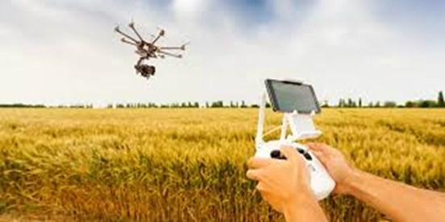
Technological innovations?
Biotechnology
Robots

Slide 26
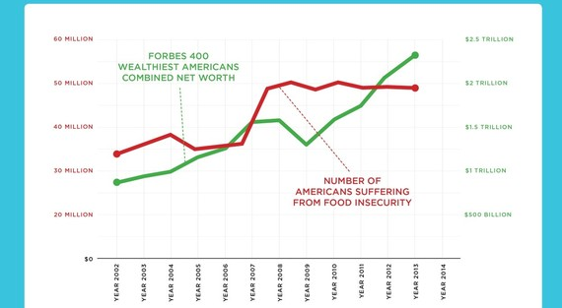
Wealth & Hunger increasing

Slide 27

1. Top 1% is benefitting from unsustainable practices, while more suffering, experiencing poverty and hunger
2. Inequality among countries 25% greater because of climate change

Slide 28
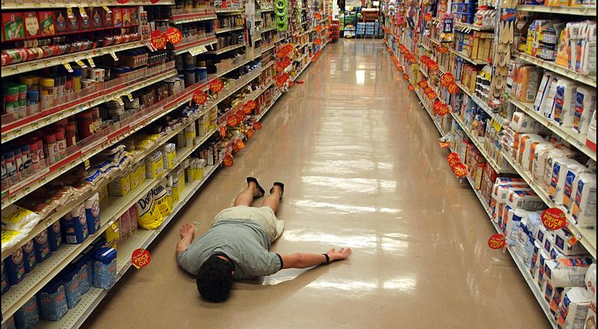
Transformation of food systems Supermarket adventure:
Problem of Excess and supermarketization of our food system

Slide 29
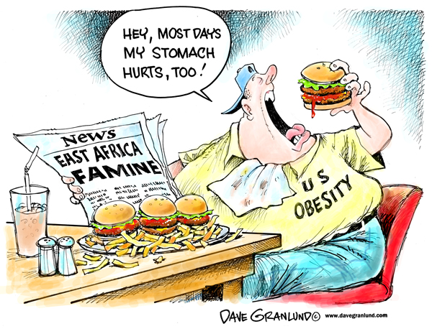
More people suffers from eating too much food than too little
1.5bn are overweight, 700 m. obese;
300m suffer from Diabetes Type 2
Obesity: 30% the US
Poor pays more, eat unhealthy food.

Slide 30
The Nutrition Problem
1 in 3 people worldwide are malnourished
2 billion
Deficient in vitamins or minerals
Deficient in vitamins or minerals
Overweight or Obese
1.9 1nillion
Chronic Hunger
151m stunted
51m wasted
38m under 5’s over
weight
1.9 billion
821 million
SOFI 2018

Slide 31
Inadequate food consumption is the common denominator in all forms of malnutrition
Anemia
Stunting
Overweight & Obesity
`Poor
diets Diets
High blood pressure
Wasting
Type 2 Diabetes

Slide 32
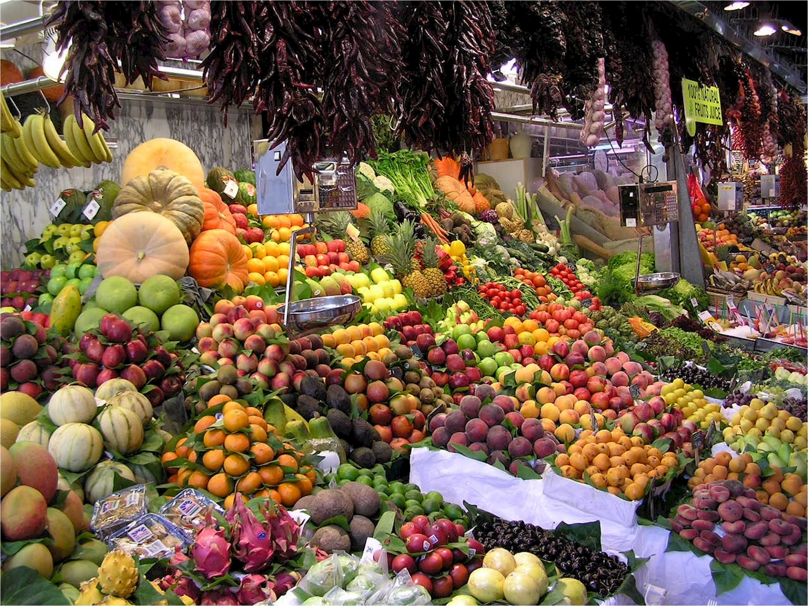
Healthy foods like fresh fruits & vegetables are unaffordable for large parts of the world
Share of per capita household income to buy
5 fruits and vegetables /day/person
52%
Bangladesh India
Pakistan Zimbabwe
Zambia
Paraguay
Argentina
Availability, affordability, and consumption of fruits and vegetables in 18 countries across income levels: findings from the Prospective Urban Rural Epidemiology (PURE) study. Miller, Victoria et al. The Lancet Global Health , Volume 4 , Issue 10 , e695 - e703

Slide 33
Advertisement versus public spending for food
$ 1 billion
Advertising spend of
Hershey and General Mills in 2016
$50m
Aid spendingNCDRelated NCDs in 2014
(2016 GNR)
https://www.nature.com/articles/d41586-018-03918-7

Slide 34
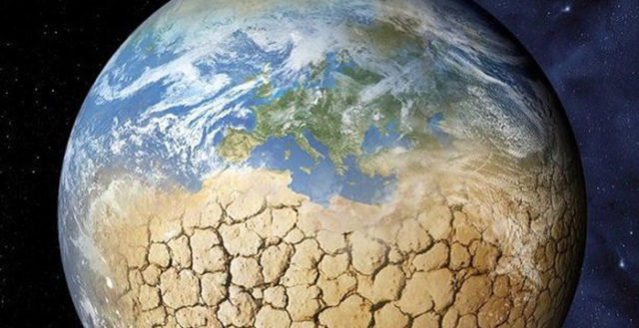
Climate Change & Food Security
Complex Relationship
Universal existential threat: Climate Change
Climate Change & Food Security
Complex Relationship
80% of all disasters, pushed 26 million to acute food insecurity in 2018, mostly in Africa, nearly 23 million people in 20 countries are acutely food insecure.

Slide 35
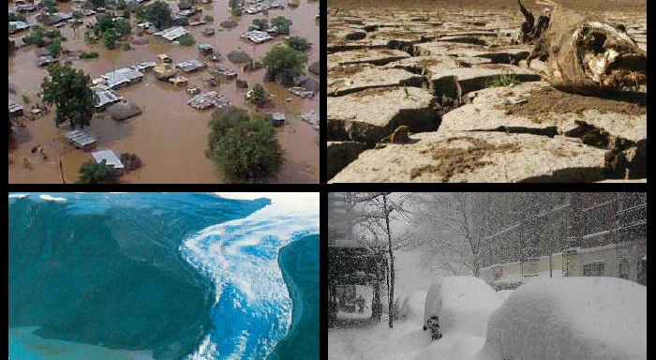
Extreme weather events:
Drought, flood & mudslide

Slide 36
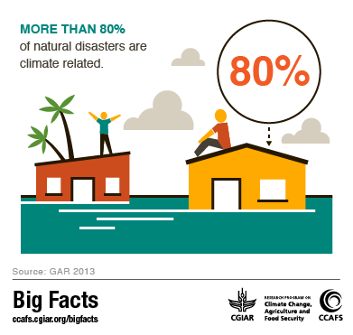
Notes:
29 million in acute insecurity in 2018. mostly in Africa , where nearly 23 million people in 20 countries are acutely food insecure

Slide 37
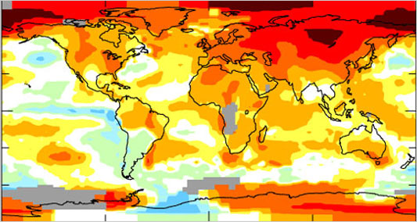
Rising Temperature 1960-2020

Slide 39
Impact on Crop Yields
By 2050, the average yield of maize, sorghum, millet, groundnut and cassava will decline by 22%, 17%, 17%, 18% and 8% respectively.
Several countries could see overall crop yields fall by 50%.
Expansion of pests, crop diseases, stressing livestock
Lower productivity higher price: Maize by 4%, rice 7%, wheat 15%
Notes:
Significant yield variation world’s top 10 crops.
In Africa will decrease 12% by 2030

Slide 40
Impact on Hunger & Malnutrition
10 to 20% hunger increase by 2050
65% of them in Sub Saharan Africa
Not only quantity but quality: malnutrition
  Zinc deficiency ( CO2 impact)
  Decline of pollinators
  Unknown impacts due to biological and chemical interaction

Slide 41
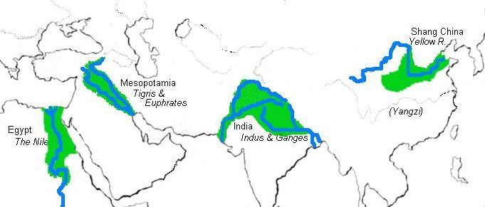
Impact on water: Indus, Ganges, Yangtze
Notes:
In the Indus, Ganges, Yellow, and Yangtze River basins, where irrigated agriculture depends heavily on the rivers, the loss of any dry-season flow is bad news for farmers. China is the world’s leading producer of wheat. India is number two. (The United States is number three.) With rice, China and India totally dominate the world harvest. Therefore, the melting of these glaciers coupled with the depletion of aquifers present the most massive threat to food security the world has ever faced.
The Ganges River is by far the largest source of surface water irrigation in India and a source of water for the 407 million people living in the Gangetic basin.

Slide 42
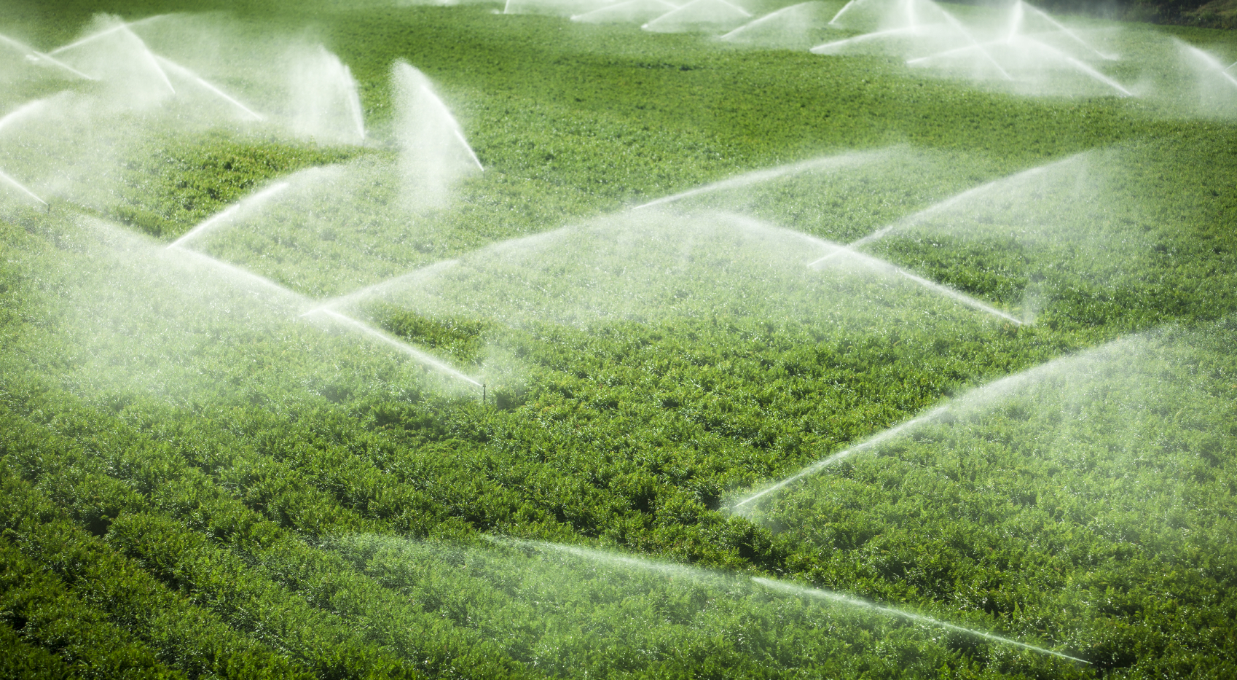
Falling water tables, slowing irrigation
Notes:
In 20th century, it expanded from 250 m. acres in 1950 to 700 m. in 2000. Between 2000-2010 only 10 % increased.
FAO Water report in Sindh 2013-2015 Drought 1.1 M. people fell below emergency level threshold. 75 % people lack of water, wide spread destruction livestock destruction 50% .

Slide 43
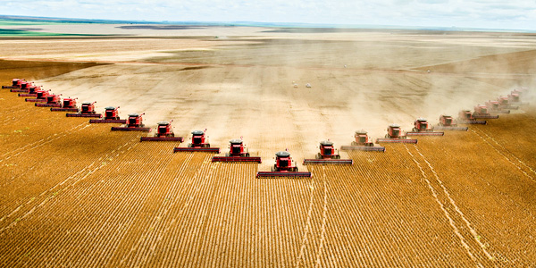
Greatest driver of climate change: Industrial agriculture
50% more food in 2050?

Slide 44
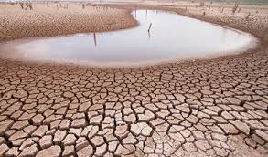
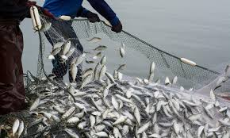
Land Degradation
29% of global land, where 3.2 billion people reside
33 % of the oceans fish stock are overfished

Slide 45
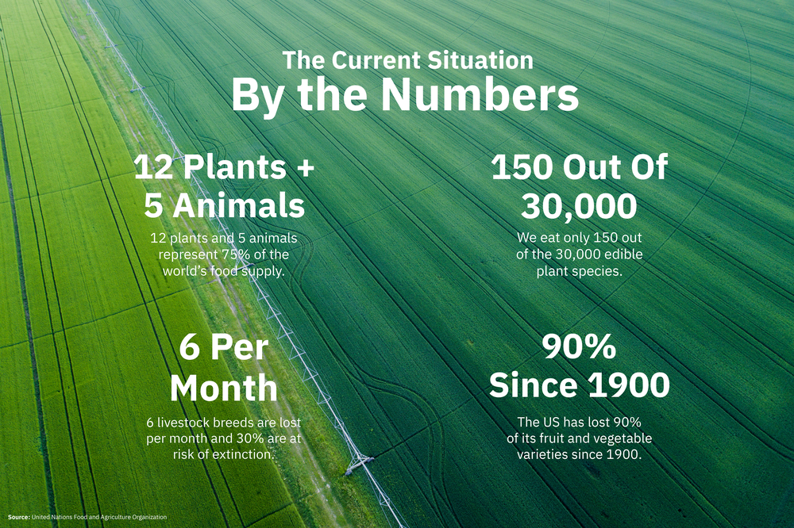
Loss of biodiversity
Notes:
Loss of pollination
Soil organism,. Livestocks, crops and key ecosystems necessary for ag;

Slide 46
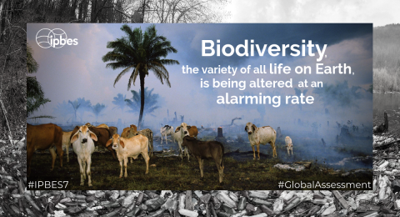
IPBES Report May 2019
Declining of Earth’s natural life support
Notes:
Intergovernmental science policy platform on biodiversity and ecosystem

Slide 47
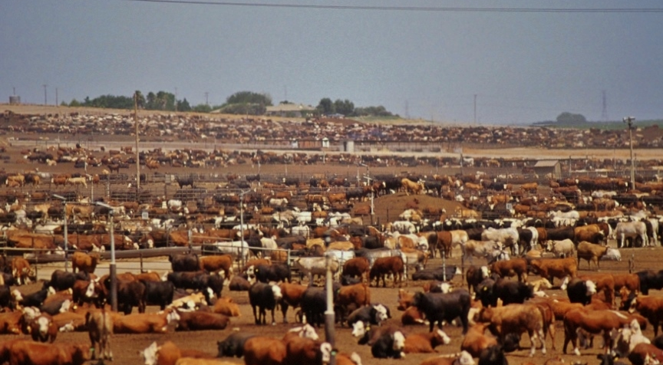
Livestock
1/3 of global agricultural GDP;
Largest user of land resources: 26% of global land and feed crops; 1/3 of arable land;
It has profound effects on the environment: indirect land-use changes and feed crop production.
Notes:
Smallholder mixed farming systems: limited access to resources, markets and services, variable resource efficiency and big yield gaps, and have little capacity to adapt to deep and rapid structural transformation in the agriculture sector and in the wider economy.
– Pastoral systems: in addition to the challenges they share with smallholders, pastoral systems must cope with conflicts for land and water, economic and political exclusion, social (including gender) inequity, poor animal health and high risks of zoonotic diseases.

Slide 48
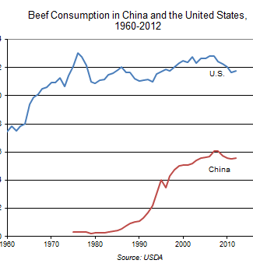
Rising populations & Changing eating habits
9 Billion in 2050 with rising income
50% more food by 2050 in order to meet global population growth. This will have to be done against a backdrop of rising energy prices and climate change.
It will be harder and more expensive to produce.

Slide 49
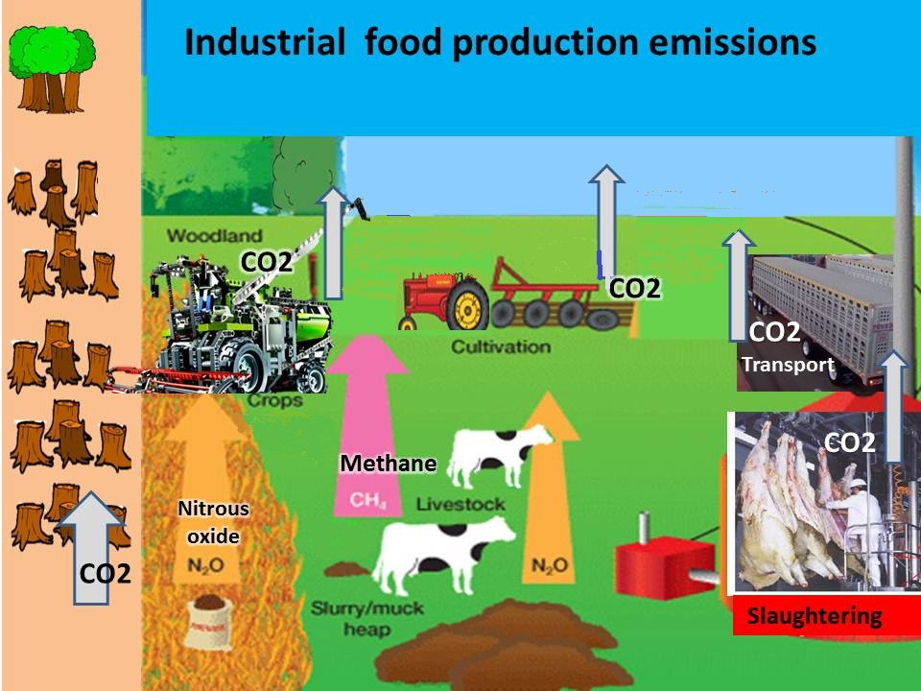
Transforming Food Systems from Industrial Agriculture

Slide 50
Notes:
The food system uses more fossil fuel than any other sector.

Slide 51
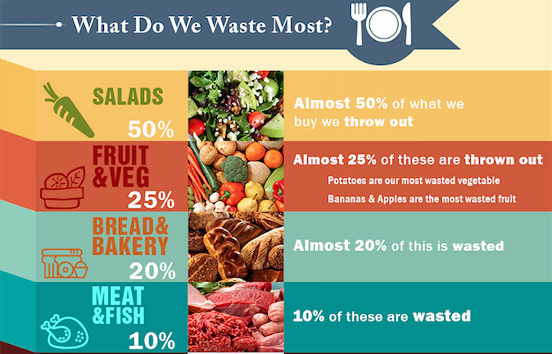
Global Food Waste:30%

Slide 52
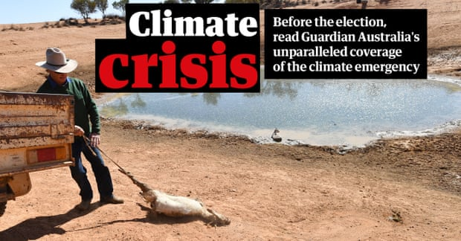
Australia’s climate change
Notes:
Guardian, 14, May 2019

Slide 53
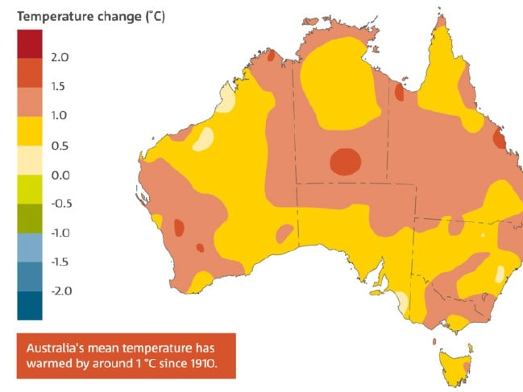

Slide 54
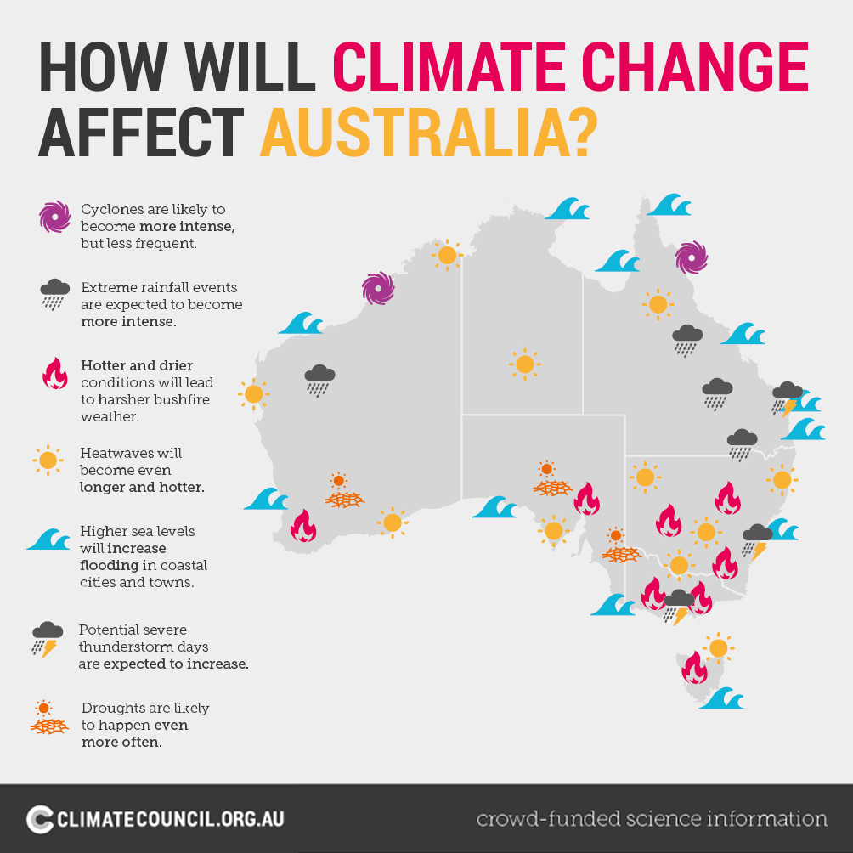

Slide 55
Australia one of the most vulnerable in developed world
5 degree Celsius rise by 2090
IPCC (Oct. 2018): 2 degree of the Paris Agreements is insufficient. 1,5 would be better
2018 historic drought, 3rd warmest, annual rainfall below 11%, lowest recorded in 2005 during the Millennium Drought
2 regions; Murray Darling basin and South west
Very bad for the Agri: 70% of winegrowing will be less suitable by 2050
Carrots, most valu. vegetable export will be less
Heat stress on dairy cows will reduce milk yield by 10-25 %.
Ocean warming and acidification from GHG impacted Great Barrier Reef. Valued over 40 billion has degradation, including |mass bleaching event| in 2016., which was made 175 times more likely by cc.

Slide 56
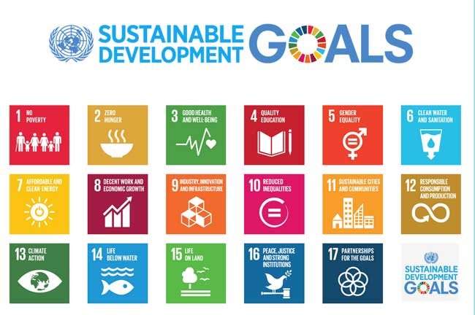
V. Taking Global Action for Future
2030 Agenda for Sustainable Development

Slide 57
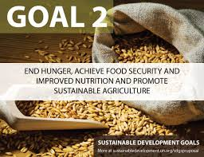

Slide 58
What future?
1. Human rights approach to food security:
  From charity to legal entitlement
  Gender equality in food and agriculture
2. Changing production methods: From industrial agriculture to ecosystem oriented production (agro-ecology)
3. Changing consumption methods:
  Less meat more plant
  Less waste
  Eat locally and seasonally
4. Democratization of food systems:
  Community Supported Agriculture
  Food Policy Councils
  Food Sovereignty

